Slide 1
Теория Информации
В.Н. Ярмолик
Лекция 23
2016

Slide 2
Steganography
CPT Scheme
CPT Scheme is the method proposed by Y.Y.Chen, H.K.Pan, Y.C.Tseng for a secure data hiding for two-color images. The CPT scheme is block-based . A binary container image F is regularly partitioned into small pixel blocks F_{i} of a size m×n (for simplicity, we assume that F’s size is a multiple of m×n). The scheme is able to hide as many as r ≤ ⎣log₂(mn+1)⎦ bits of the secret message in each host block by modifying at most 2 bits in the block. The secret key has two components:
  K: a randomly selected binary matrix of size m×n.
  W: a weight matrix which is an integer matrix of size m×n. W satisfies the condition that {[W]_{i,j}|i=1,...,m; j=1,...,n}={1,2,...,2^{r}-1}. Note that since 2^{r} ≤ 2^{⎣log}2^{(mn+1)⎦} ≤ 2^{log}2^{(mn+1)} ≤ mn+1, it is trivial to fined a matrix that can serve as a weight matrix.

Slide 3
Steganography
CPT Scheme
In the fact, the number of choices for W can be calculated as: C_{2r-1}^{mn}×(2^{r}-1)!×(2^{r}-1)^{mn-(2r-1)} For instance, if m=n=8 and r=5, there are C₃₁⁶⁴×31!×31³³ possible W’s . This number should be large enough to prevent a brute-force attack.
The data hiding is achieved by modifying some bits of F. Below (next slide) we show how to hide a bit stream b₁b₂,…,b_{r} into an m×n host block, say F_{i}.
CPT Scheme hiding algorithm.
S1. Compute F_{i}⊕K, where ⊕ means the bit wise Exclusive-Or of two equal-size binary matrices. S2. Compute SUM((F_{i}⊕K)⊗W), where ⊗ means the pair wise multiplication of two equal-size matrices and SUM means the sum of all elements in matrix.

Slide 4
Steganography
CPT Scheme
S3. From the matrix F_{i}⊕K, compute for each w=1,...2^{r}-1 the following set: S_{w}={(j,k)|([W]_{j,k} = w∧[F_{i}⊕K]_{j,k}= 0∨([W]_{j,k} = 2^{r}-w∧[F_{i}⊕K]_{j,k}=1)}. Intuitively, S_{w} is the set containing every matrix index (j,k) such that if we complement [F_{i}]_{j,k}, we can increase the sum in step S2 by w. There are actually two possibilities to achieve this:
(i) if [W]_{j,k}=w and [F_{i}⊕K]_{j,k}= 0, then complementing [F_{i}]_{j,k} will increase the weight by w, and
(ii) if [W]_{j,k}=2^{r}-w and [F_{i}⊕K]_{j,k}=1, then complementing [F_{i}]_{j,k} will decrease the weight by 2^{r}-w, or equalently increase the sum by w (under mod 2^{r}). Also, define S_{w}=S for any w=w’ mod 2^{r}.
S4. Define a weight difference d=(b₁b₂,...,b_{r})-SUM((F_{i}⊕K)⊗W) mod 2^{r}. If d = 0, there is no need to change F_{i}. Otherwise, we run the following program to transform F_{i} to F’_{i}.

Slide 5
Steganography
CPT Scheme
Program to transform F_{i} into F’_{i}.
(hd mod 2^{r} ) + (-(h-1)d mod 2^{r} ) = d
a) Randomly pick an h∈{1,...,2^{r}-1} such that S_{hd}≠∅ and S_{-(h-1)d}≠∅. Indexes hd and –(h-1)d are used by mod 2^{r} . b) Randomly pick a (j,k)∈S_{hd} and complement the bit [F_{i}]_{j,k}.
c) Randomly pick a (j,k)∈S_{-(h-1)d} and complement the bit [F_{i}]_{j,k}.
To summarize, the above steps ensure the following invariant:
SUM((F’_{i}⊕K)⊗W) = b₁b₂,...,b_{r} mod 2^{r}

Slide 6
Steganography
CPT Scheme
In the above step S4, we pick two nonempty sets S_{hd} and S_{-(h-1)d}. Since these sets indicate the locations where we can complement F_{i} to increase the weight by hd and –(h-1)d, respectively. The overall effect is an increase of the weight by d. It is proved that step S4 will always succeed. However, there are logical flaws in the above program, which we left out intentionally for ease of presentation. First, the set S₀ (and similarly S₂r and so on) is not yet defined. Like other S_{w}’s we can regard S₀ as the set of indices such that complementing these locations in F_{i} will result in an increase of weight by 0. Since this can be achieved by changing nothing on F_{i}, we can always regard S₀ as nonempty and whenever the statement

Slide 7
Steganography
CPT Scheme
CPT Scheme hiding algorithm example
For example, let the host image F, secret key K, and weight matrix W are shown below
F₁
F₂
0 | 1 | 0 | 1
1 | 0 | 0 | 0
1 | 0 | 0 | 0
0 | 0 | 0 | 0
1 | 0 | 0 | 0
1 | 0 | 1 | 0
0 | 1 | 1 | 1
0 | 1 | 1 | 1
1 | 1 | 0 | 0
0 | 1 | 0 | 0
1 | 1 | 1 | 0
0 | 0 | 1 | 0
1 | 2 | 3 | 4
5 | 6 | 7 | 1
2 | 3 | 4 | 5
6 | 7 | 1 | 2
F =
K =
W =

Slide 8
Steganography
CPT Scheme
First, F is partitioned into two 4×4 blocks, F₁ and F₂. We can hide r ≤ ⎣log₂(4×4+1)⎦
b₁b₂b₃=001 b₁b₂b₃=001
1 | 0 | 0 | 1
1 | 1 | 0 | 0
0 | 1 | 1 | 0
0 | 0 | 1 | 0
0 | 1 | 0 | 0
1 | 1 | 1 | 0
1 | 0 | 0 | 1
0 | 1 | 0 | 1
S1
F₁⊕ K =
F₂⊕ K =
S2
1 | 0 | 0 | 1
1 | 1 | 0 | 0
0 | 1 | 1 | 0
0 | 0 | 1 | 0
1 | 2 | 3 | 4
5 | 6 | 7 | 1
2 | 3 | 4 | 5
6 | 7 | 1 | 2
SUM((F₁⊕K)⊗W)
mod 2³=
×
= (1+4+5+6+3+4+1) mod 2³ = 0

Slide 9
Steganography
CPT Scheme
S3. S₁={(2,4)}; S₂={(1,2), (3,1), (4,4), (2,2)}; S₃={(1,3), (2,1)}; S₄={(1,4), (3,3)}; S₅={(3,4), (3,2)}; S₆={(4,1)}; S₇={(2,3), (4,2), (1,1), (4,3)}.
S4.The weight difference d=(b₁b₂b₃)-SUM((F₁⊕K)⊗W)=001-0=1-0=1. If d≠0 there is need to change F₁. We run the following program to transform F₁ to F₁’.
a) For any h there is the possibility to use one S_{w} out of all possible.
b) Randomly we a picking a (j,k)=(2,4) and complement the bit [F₁]_{2,4} to new value 1.
c) Due to [W]_{2,4} has the value 1 what exactly equals to d=1 we should not make any changes for F₁ yet.

Slide 10
Steganography
CPT Scheme
For F₂, since SUM((F₂⊕K)⊗W) mod 2³=(2+5+6+7+2+5+7+2) mod 2³=4. The weight difference d = 1- 4 = - 3= 5. Thus, swapping [F₂]_{2,2} and [F₂]_{3,2} will increase the weight by [W]_{2,2}= -6=2 and [W]_{3,2}=3, respectively. The resulting F with modified bits are shown below.
0 | 1 | 0 | 1
1 | 0 | 0 | 1
1 | 0 | 0 | 0
0 | 0 | 0 | 0
1 | 0 | 0 | 0
1 | 1 | 1 | 0
0 | 0 | 1 | 1
0 | 1 | 1 | 1
F’
F₁’
F₂’

Slide 11
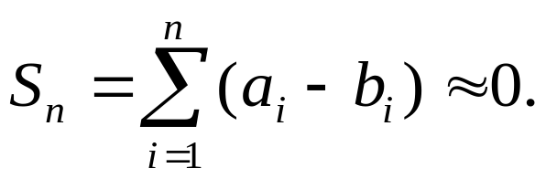
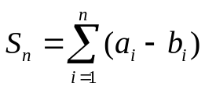
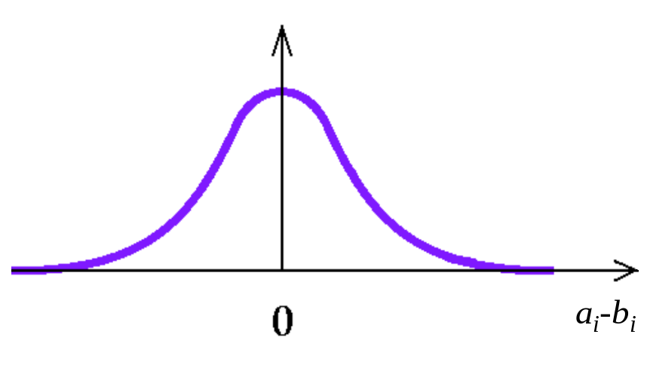
Steganography
Patchwork Method
Patchwork Method (W.Bender, 1996),
Patchwork method is based on the peculiarity of the graphic images that for large enough number n pair of pixels A and B with the values a and b, the parameter
has the value very close to zero. The distribution of S = a – b is shown below.

Slide 12
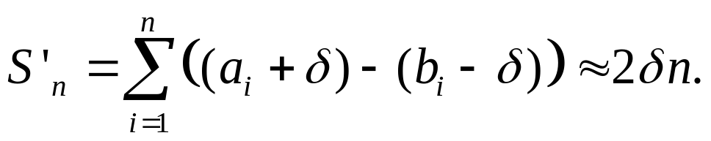
Steganography
Patchwork Method
The Patchwork method consists of changing of brightness of random chosen set of pixels pairs (a_{i}, b_{i}), such a way that the value of S’_{n}, for this set will be sufficiently high compare with zero.
Patchwork watermark embedding algorithm:
1. Based on psedorandom number generator the pair (A,B) of pixel with the brightness (a_{i}, b_{i}) should be chosen;
2. The brightness a_{i} is increasing on value δ;
3. The brightness b_{i} is decreasing on value δ;
Steps 1 – 3 repeats n times.
Then the value of S’_{n} is determined as

